Slide 1
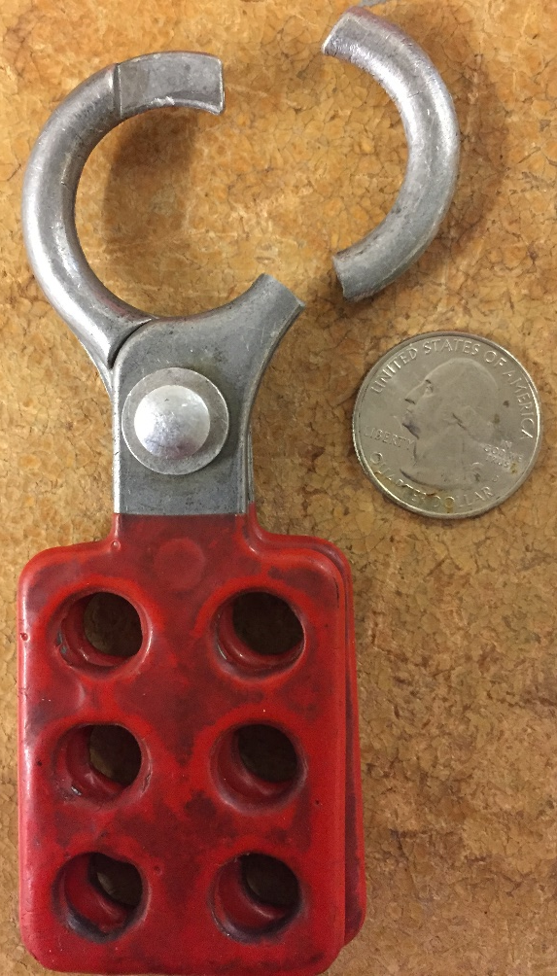
Electrical Safety Alert
LOTO Hasp Breaks When Challenging Lock During LOTO
Lessons Learned
Inspect your safety equipment before each use.
Challenge the LOTO devices to ensure they provide adequate safety measures; Never attempt to operate the isolation if there is any other LOTO lock on the device.
What Happened
Facility Electricians had de-energized and performed zero energy verification for a piece of equipment as part of a Lockout/Tagout procedure. The hasp pictured to the right was applied to the energy isolation as part of the LOTO.
An Engineering Technician planning to work on the LOTO’d equipment placed his lock and tag on the pictured hasp, along with the other locks already applied. The technician noticed that the hasp was cocked at an odd angle. He then challenged the lock by tugging on it several times to ensure it was latched, per his LOTO training. The metal of the hasp snapped as shown.
An immediate stop work was called, and Facilities electricians were called to re-establish and re-verify the LOTO before work continued.
What You Can Do
The brand of the pictured hasp is unknown, although it has been determined that this is not a Master Lock. It is recommended that all departments and personnel check their LOTO hasps for evidence of impending failure, such as stress cracks.
Remember to inspect your safety equipment before each use.
Remember to challenge your LOTO devices when applying them. Do not challenge LOTO’d switches if you are joining work already in progress.
Electrical Safety Alert 2015-02
03/06/2015

